Slide 1

LINEAR CONTROL
SYSTEMS
Ali Karimpour
Assistant Professor
Ferdowsi University of Mashhad
Notes:
<<<1.1>>>
###Control System Design###
{{{Control, Design}}}

Slide 2
Lecture 15
Time domain analysis of control systems
Topics to be covered include:
Effect of adding poles and zeros to:
  Open-loop transfer function.
  Closed-loop transfer function.
Importance of zeros in transfer functions.
Dominant poles of transfer function.
Approximation of high-order systems by low-order systems.

Slide 3


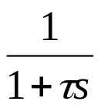
Adding poles to open loop and closed loop transfer functions
اضافه کردن قطب به تابع انتقال حلقه باز و حلقه بسته
r
e
c₁
+
-
r
c₁
Adding pole to open loop transfer function
Adding pole to closed loop transfer function
r
e
c₂
r
c₂
-

Slide 4

Adding zeros to open loop and closed loop transfer functions
اضافه کردن صفر به تابع انتقال حلقه باز و حلقه بسته
r
e
c₁
+
-
r
c₁
Adding zero to open loop transfer function
Adding zero to closed loop transfer function
r
e
c₂
-
r
c₂

Slide 5
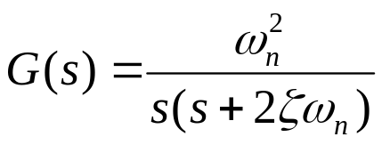
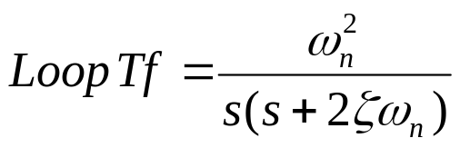
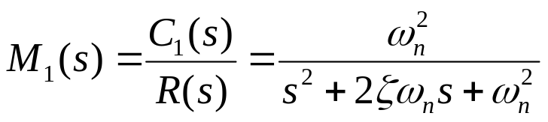
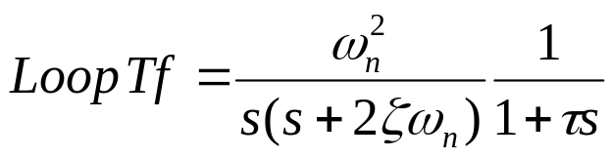
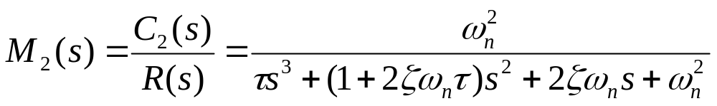
Adding poles to open loop transfer functions
اضافه کردن قطب به تابع انتقال حلقه باز
r
e
c₁
r
e
c₂
+
-
-
Let
Before adding pole
After adding pole

Slide 6






Adding poles to open loop transfer functions
اضافه کردن قطب به تابع انتقال حلقه باز
r
e
c₁
r
e
c₂
+
-
-
Note: For τ<0 system is unstable. Why?

Slide 7
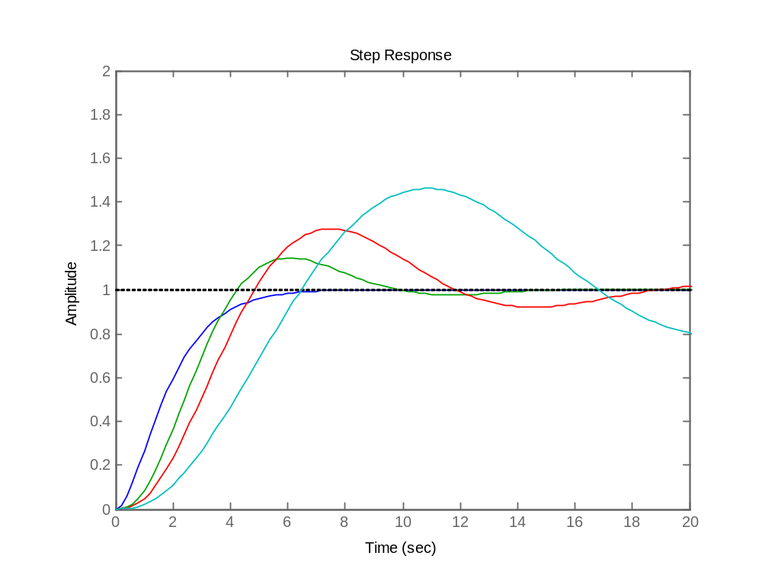
Adding poles to open loop transfer functions
اضافه کردن قطب به تابع انتقال حلقه باز
r
e
c₂
-
τ=5.0
τ=2.0
τ=1.0
τ=0

Slide 8
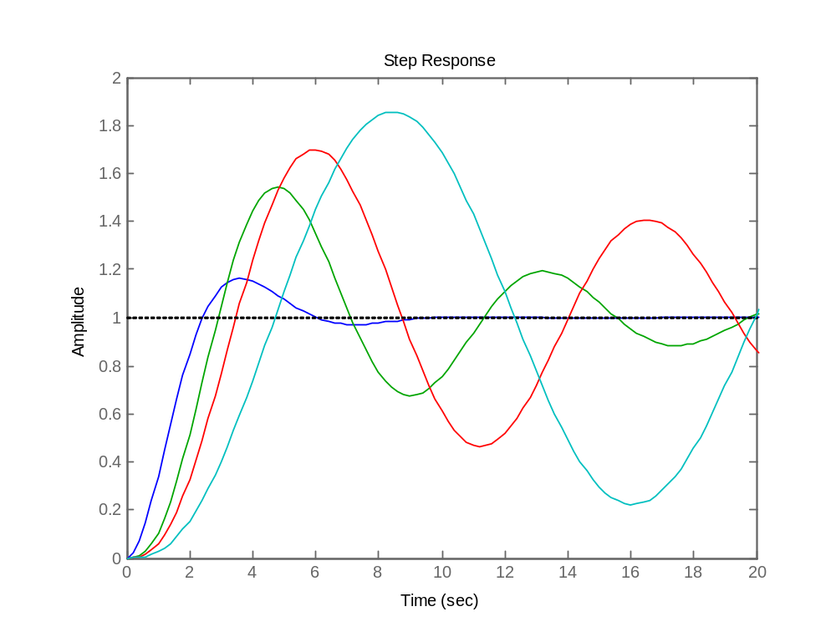
Adding poles to open loop transfer functions
اضافه کردن قطب به تابع انتقال حلقه باز
r
e
c₂
-
P.O.
τ=5.0
τ=2.0
t_{r}
τ=1.0
τ=0
System speed
BW
More problem as
poles go to ??

Slide 9

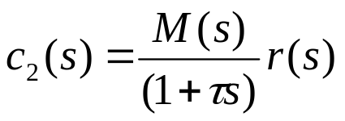
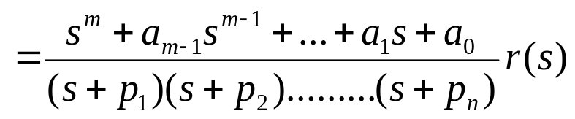
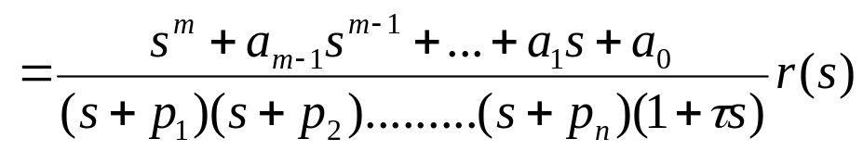
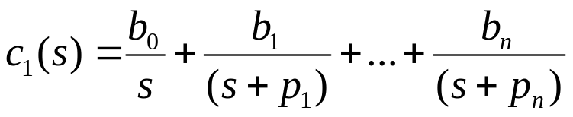
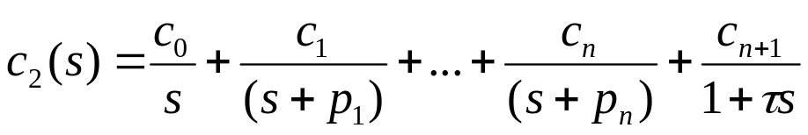
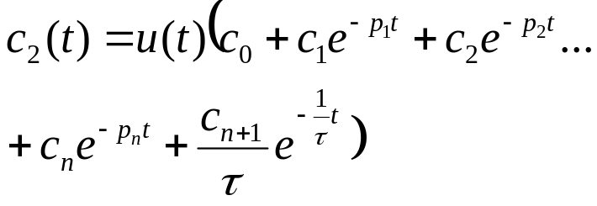
Adding poles to closed loop transfer functions
اضافه کردن قطب به تابع انتقال حلقه بسته
r
c₁
r
c₂
Before adding pole
After adding pole
Step response before adding pole
Step response after adding pole

Slide 10
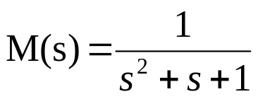
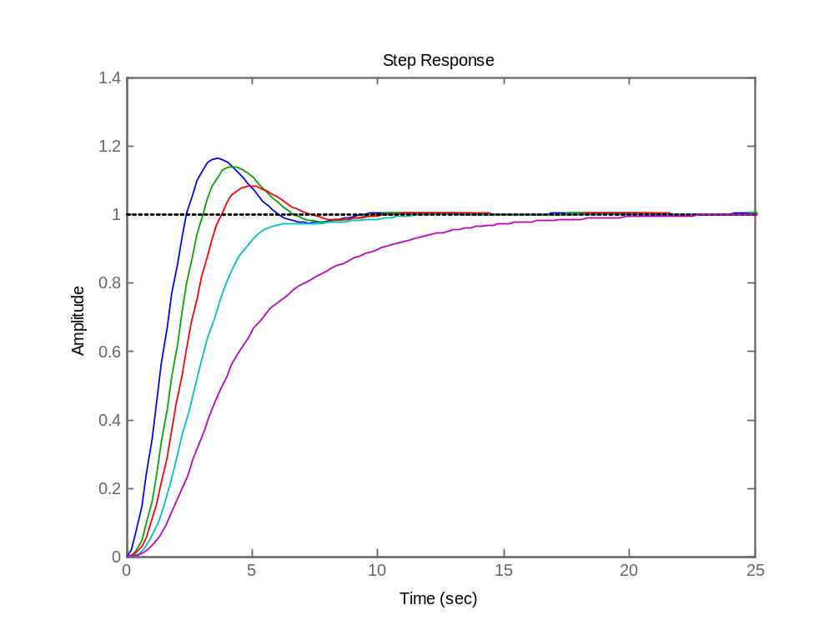
Adding poles to closed loop transfer functions
اضافه کردن قطب به تابع انتقال حلقه بسته
r
c₂
P.O.
τ=0.5
t_{r}
τ=0
τ=1.0
τ=2.0
τ=5.0
System speed
BW
More problem as
poles go to ??
Note: For τ<0 system is unstable. Why?

Slide 11




Adding zeros to closed loop transfer functions
اضافه کردن صفر به تابع انتقال حلقه بسته
r
c₁
r
c₂
Before adding
After adding
لذا پاسخ سیستم پس از اضافه کردن صفر به تابع انتقال حلقه بسته = جمع پاسخ سیستم ابتدائی با τ برابر مشتق آن
System response after adding zero to closed loop transfer function = sum of origin system response and τ times of its derivative

Slide 12
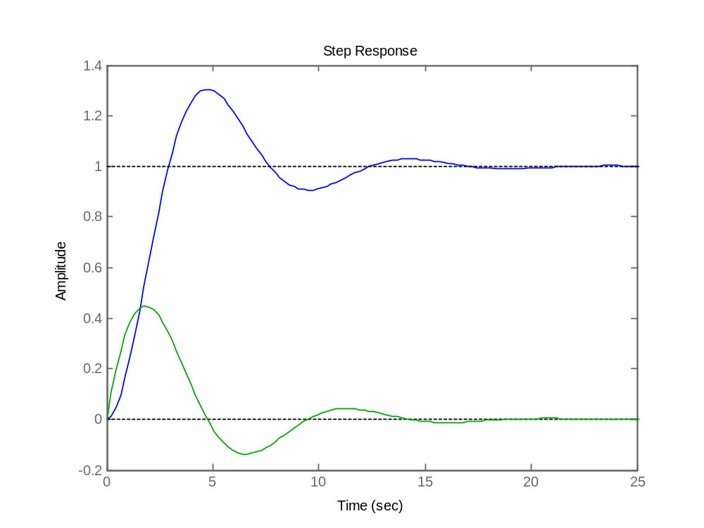
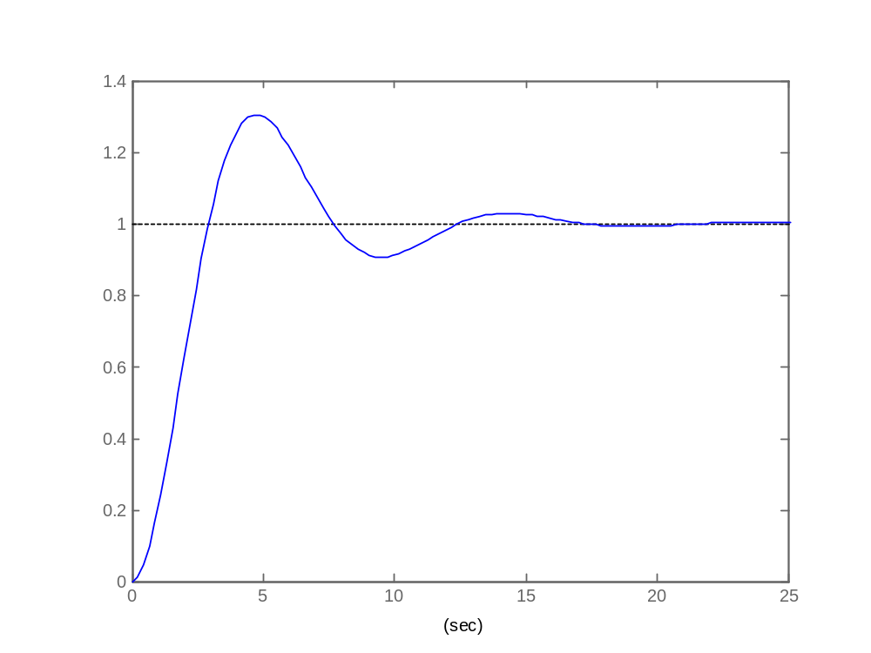


Adding zeros to closed loop transfer functions
اضافه کردن صفر به تابع انتقال حلقه بسته
r
c₁
r
c₂

Slide 13
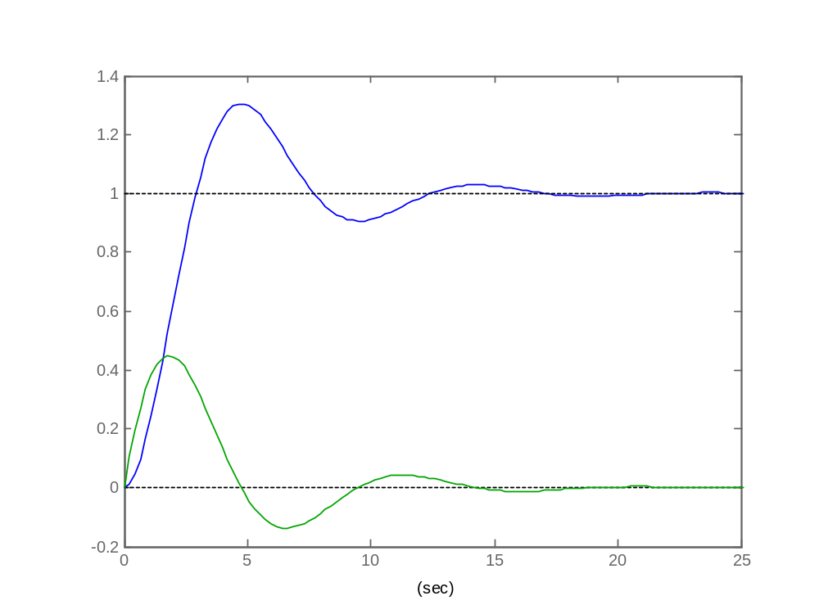
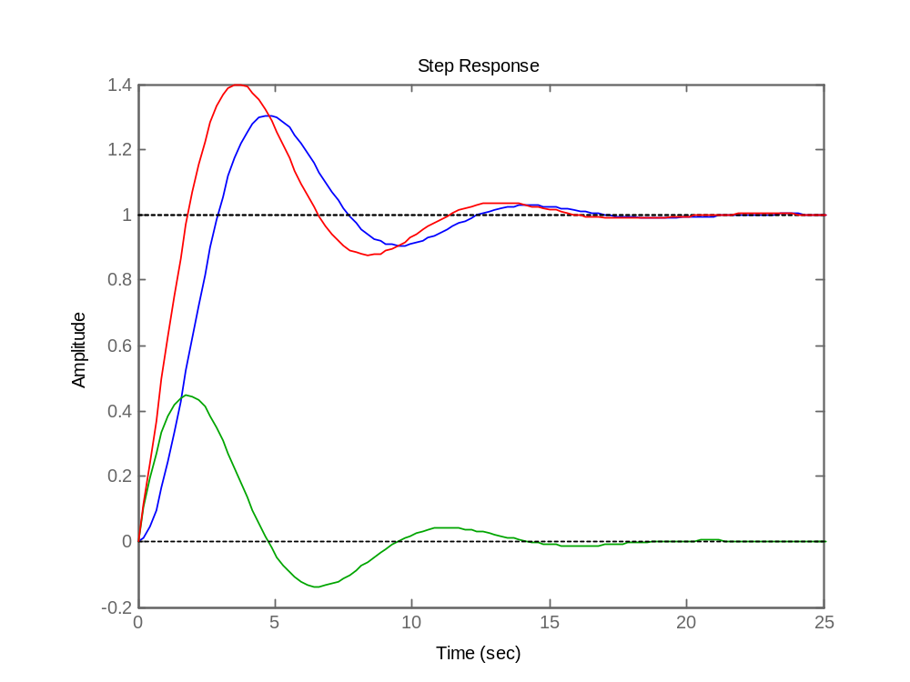



Adding zeros to closed loop transfer functions
اضافه کردن صفر به تابع انتقال حلقه بسته
r
c₁
r
c₂

Slide 14
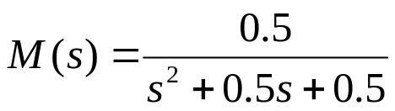
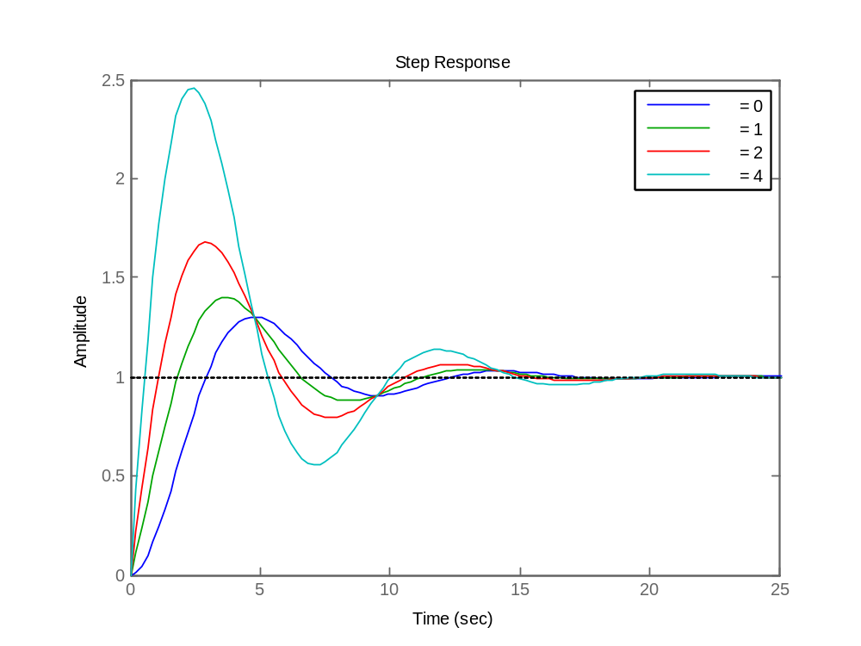



Adding zeros to closed loop transfer functions
اضافه کردن صفر به تابع انتقال حلقه بسته
r
c₁
r
c₂
step(.5,[1 .5 .5]);hold on
step([0.5 0.5],[1 .5 .5])
step([1 0.5],[1 .5 .5])
step([2 0.5],[1 .5 .5])

Slide 15
Adding zeros to closed loop transfer functions
اضافه کردن صفر به تابع انتقال حلقه بسته
r
c₁
r
c₂
P.O.
t_{r}
System speed
BW
More problem as
zeros go to ??

Slide 16

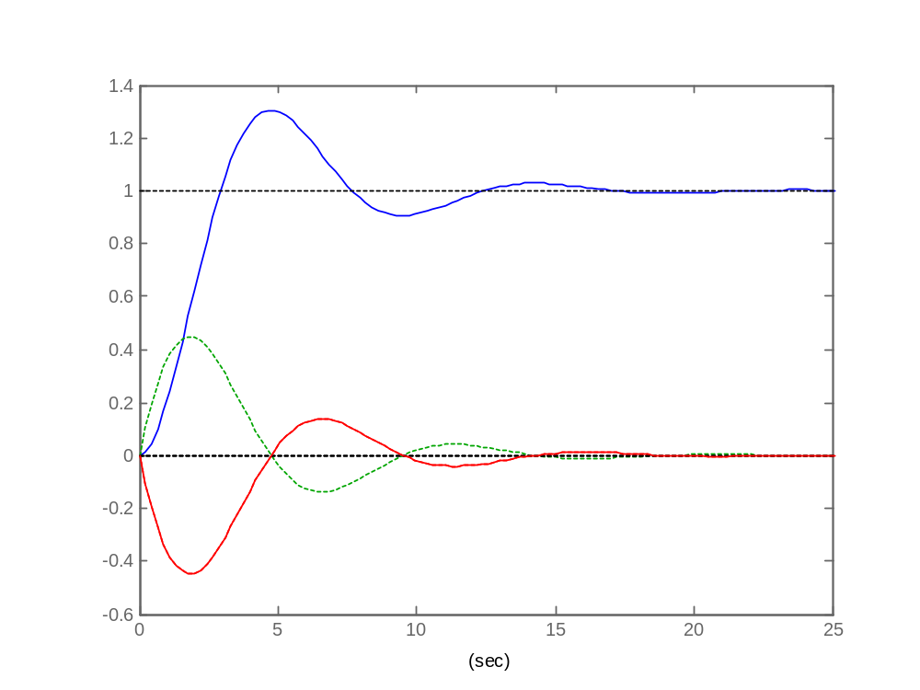
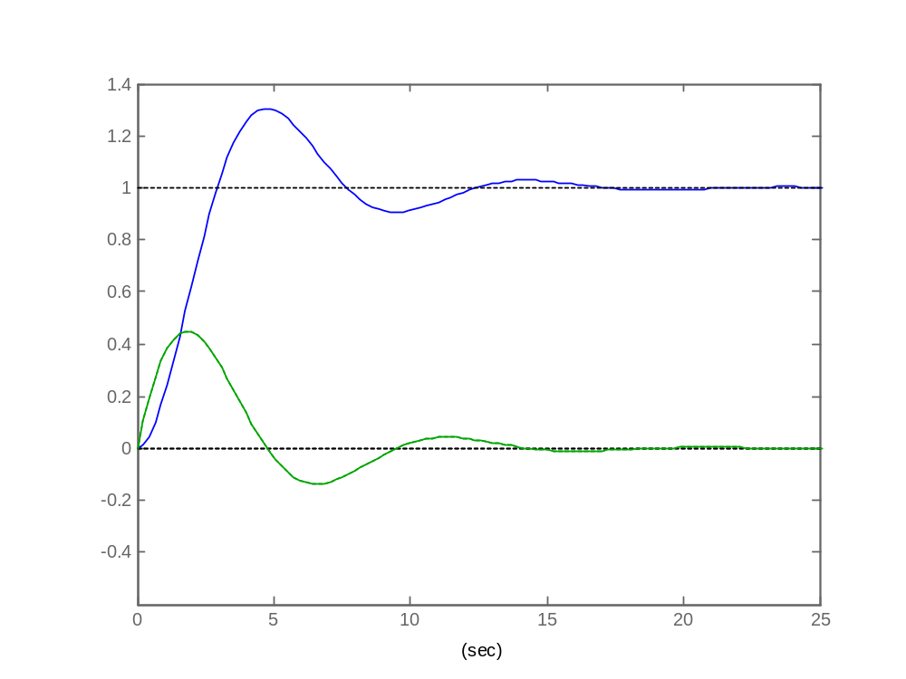
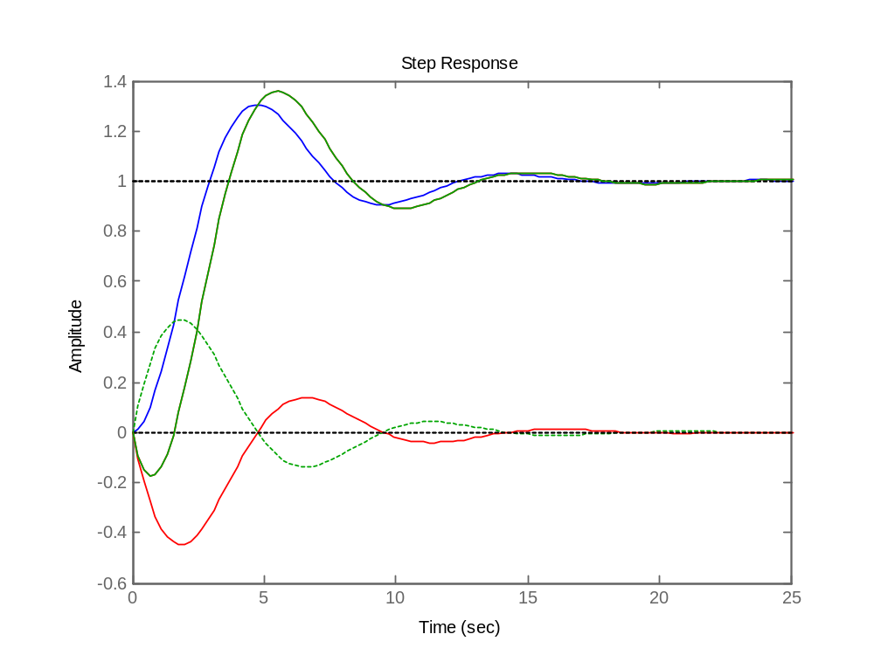

Adding RHP zeros to closed loop transfer functions
اضافه کردن صفرRHP به تابع انتقال حلقه بسته
r
c₁
r
c₂

Slide 17
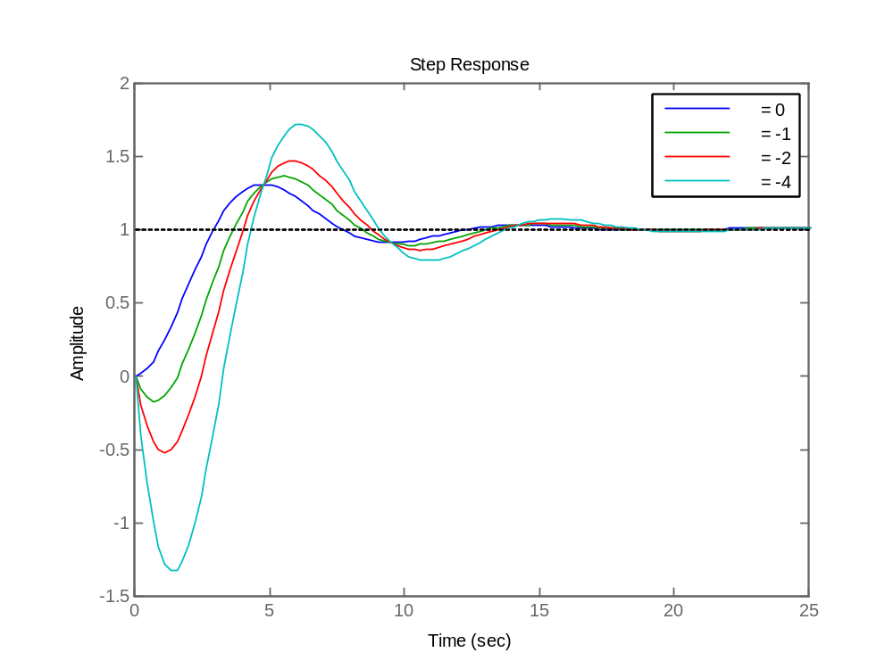



Adding RHP zeros to closed loop transfer functions
اضافه کردن صفرRHP به تابع انتقال حلقه بسته
r
c₁
r
c₂
step(.5,[1 .5 .5]);hold on
step([-0.5 0.5],[1 .5 .5])
step([-1 0.5],[1 .5 .5])
step([-2 0.5],[1 .5 .5])

Slide 18
Adding RHP zeros to closed loop transfer functions
اضافه کردن صفرRHP به تابع انتقال حلقه بسته
r
c₁
r
c₂
P.O.
t_{r}
System speed
More problem as
zeros go to ??

Slide 19

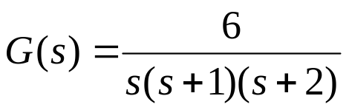
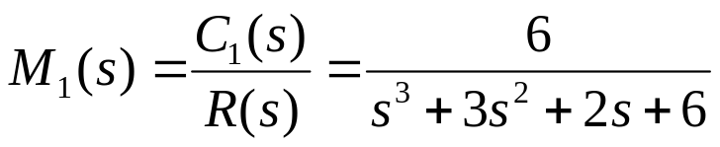
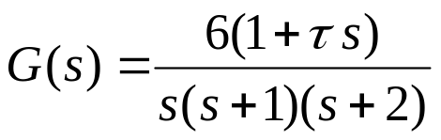
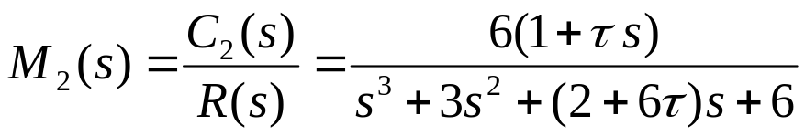
Adding zeros to open loop transfer functions
اضافه کردن صفر به تابع انتقال حلقه باز
r
e
c₁
r
e
c₂
+
-
-
Let
Before adding zero
After adding zero

Slide 20

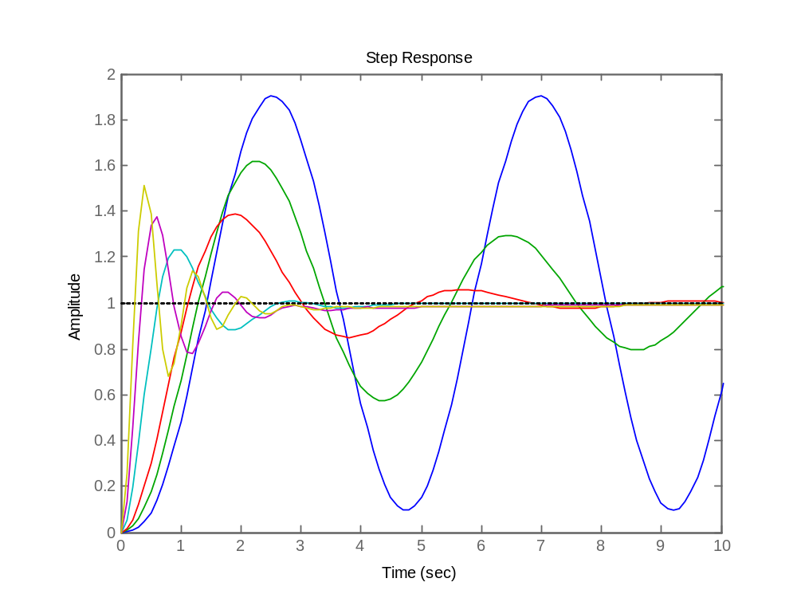
Adding zeros to open loop transfer functions
اضافه کردن صفر به تابع انتقال حلقه باز
r
e
c₂
-
P.O.
τ=0
τ=0.2
t_{r}
τ=10
τ=5.0
τ=0.5
τ=2.0
System speed
BW
Note: For τ<0 system
is unstable. Why?

Slide 21
Importance of zeros in transfer functions
اهمیت صفرها در تابع انتقال
We see that the performance of system is concerned to :
Poles and zeros not just poles

Slide 22
Real dominant poles of transfer function.
قطبهای غالب حقیقی در تابع انتقال
Region of insignificant
poles
Region of dominant
poles
Unstable
Region
D
d
What about D?
D > 5 or 10 times of d.

Slide 23
Complex dominant poles of transfer function.
قطبهای غالب مختلط در تابع انتقال
Region of insignificant
poles
Region of dominant
poles
Unstable
Region
d
D
What about D?
D > 5 or 10 times of d.

Slide 24

Design procedure.
روش طراحی
For design purposes, such as in the pole placement design we try to put poles on:
در طراحی ها، مثلا در جاگذاری قطب سعی می کنیم قطبها در مکان زیر قرار گیرند.
Region of dominant
poles
Region of insignificant
poles
D

Slide 25
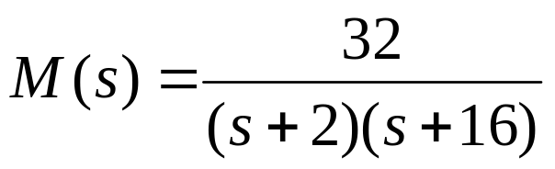
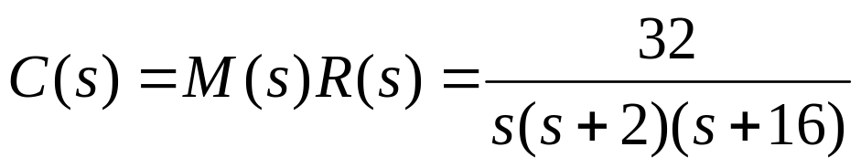
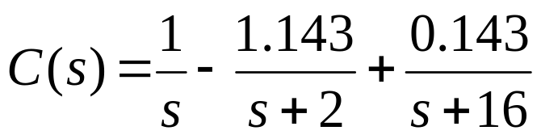
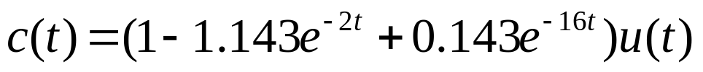
Example 1: What are the dominant poles of the following transfer function.
مثال 1: قطبهای غالب در تابع انتقال زیر را بیابید.
dominant
Step
response
insignificant
0
dominant
insignificant

Slide 26
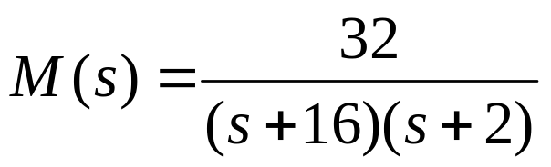
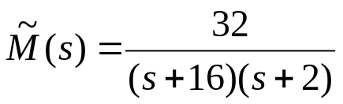
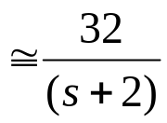
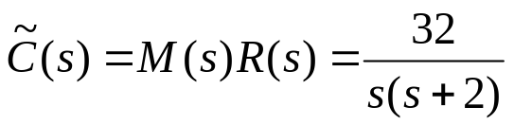
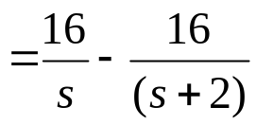

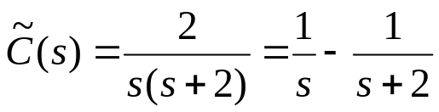
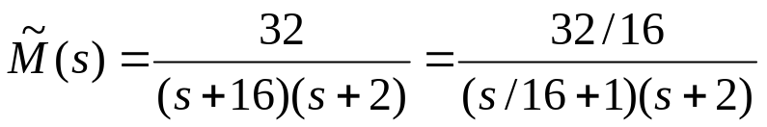
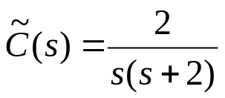
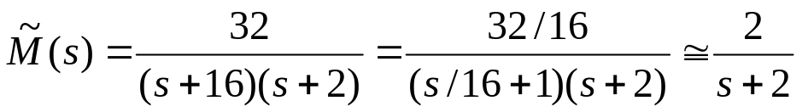

Example 2: Simplify the system in example 1.
مثال 2: سیستم مثال 1 را ساده کنید.
Step
response
غ ق ق
Step
response

Slide 27
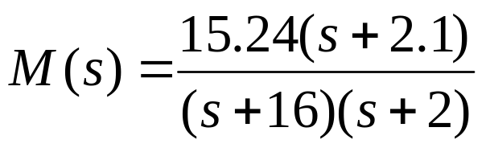
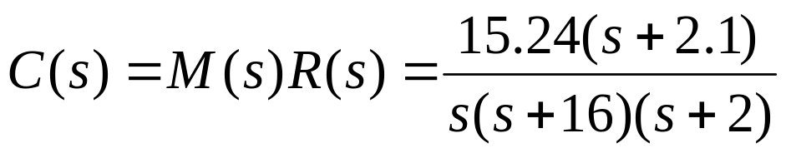
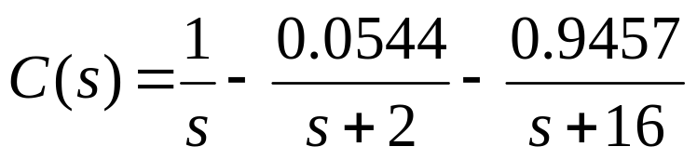
Example 3: What are the dominant poles of the following transfer function.
مثال 3: قطبهای غالب در تابع انتقال زیر را بیابید.
Step
response
dominant
insignificant
0
The zero near to pole
makes it insignificant
insignificant
dominant

Slide 28
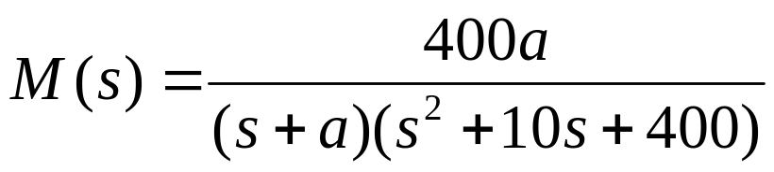
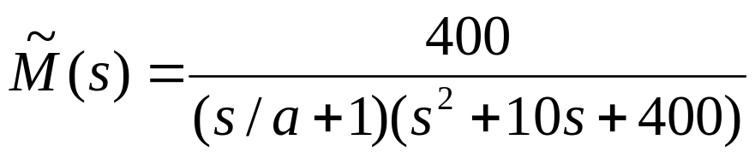
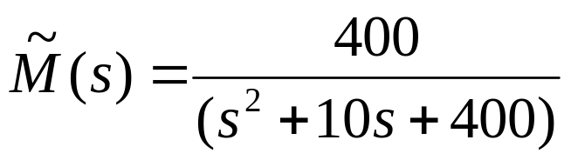
Example 4: Discuss the dominant poles of following system.
مثال 4: در مورد قطبهای غالب سیستم زیر بحث کنید.
20
dominant
-a
-5
Simplification
If (a-5) > 5 ∙ 20=100
for a > 105

Slide 29

Example 5: Compare the step response of M and its approximation for different values of k.
مثال 5: پاسخ پله M و تقریب آن را برای مقادیر مختلف a بدست آورید.
a=100
2nd order
a=50
a=20
step(400,[1 10 400]);hold on
a=10;step(400*a,conv([1 a],[1 10 400])
a=20;step(400*a,conv([1 a],[1 10 400]))
a=50;step(400*a,conv([1 a],[1 10 400]))
a=100;step(400*a,conv([1 a],[1 10 400]))
a=10

Slide 30

Exercises
تمرینها
1 Consider following system. Find the dominant poles and insignificant poles of system.
2 Derive a suitable second order system for following system.
3 Compare the step response of the system in problem 2 and step response of its second order approximation.
Notes:
<<<3.6>>>
###State Space Models###

Slide 31

Exercises
تمرینها
4 Consider following system. Find the dominant poles and insignificant poles of system.
5 Derive a suitable second order system for following system.
6 Compare the step response of the system in problem 5 and step response of its second order approximation.
Notes:
<<<3.6>>>
###State Space Models###

